Slide 1
Introduction to Programming for Machine Learning:
PyTorch Lightning and GitHub Copilot

Slide 2
Roadmap
Overview of Programming for ML Flow
PyTorch Lightning
What is PyTorch Lightning?
Key Features
Comparison Code to PyTorch
GitHub Copilot
What is GitHub Copilot?
How Does Copilot Work?
MNIST Image Classification Using Lightning and Copilot
What is MNIST?
Hands-on Coding Exercise

Slide 3
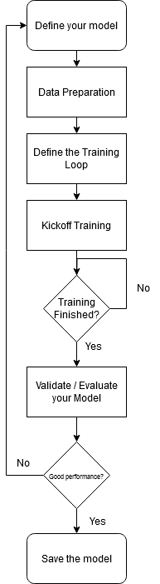
Flowchart of Programming for ML
Define your model
  What do you want the architecture of your model to be?
  Specify the number of layers, types of layers (Convolution, Batch Normalization, etc.), activation functions, or other components
Data Preparation
  Load and preprocess your training / validation data
  Apply any necessary transformations or data augmentations
Define the Training Loop / Phase
  Specifically, how are you implementing training?
  Specify the number of epochs, the desired optimizer, what loss function will be used, and other training components

Slide 4
Flowchart of Programming for ML (continued)
4. Validate / Evaluate your Model
  Use the validation and/or test dataset to assess the performance of the trained model
  Pass the validation / test data through your model to obtain predictions
  Calculate evaluation metrics such as accuracy, precision, recall, or any other relevant metrics
Save the model
  Save the trained model’s parameters or the entire model for future use
  You can load a saved model to make predictions or even continue training from a saved checkpoint

Slide 5


What is PyTorch Lightning?
PyTorch Lightning is a lightweight PyTorch wrapper that simplifies the process of organizing, training, and evaluating deep learning models
Since the flowchart for ML Programs are (roughly) the same between each project, Lightning aims to abstract away this “boilerplate code”
This frameworks provides a more structured and standardized approach to developing PyTorch-based projects

Slide 6
Key Features of PyTorch Lightning
`LightningModule` Class
  The “main building block” in PyTorch Lightning
  Encapsulates the model architecture, training and validation steps, and data pre-processing all in one
`Trainer` Class
  Automatically handles the training loop, removing the need to write explicit training code
  You just need to pass in “training hyperparameters” (number of epochs, batch size, etc.)
Callbacks
  Python hooks which allow custom actions to be executed at different stages of the training process
  For instance:
    How to handle training at each step and/or epoch
    Implement early stopping and learning rate schedule
    And more!

Slide 7
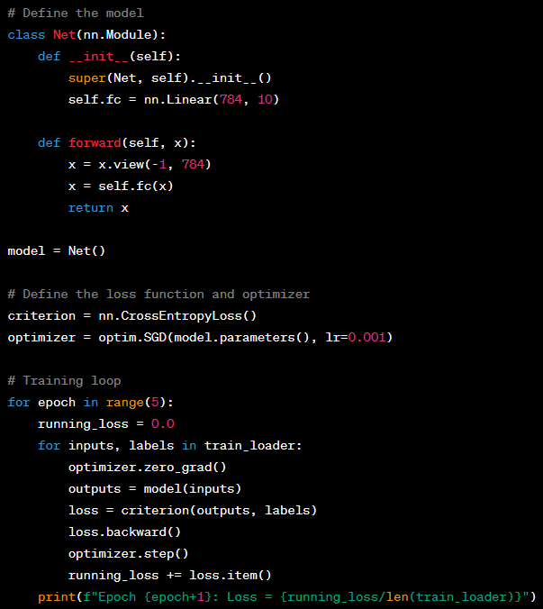
PyTorch Example – Train a Simple Linear Model
1. Define your model (architecture and forward pass calculation)
2. Instantiate your model
3. Define your loss function and optimizer
4. Manually iterate through each epoch
5. Manually track your epoch loss
6. Manually iterate through each example in your training dataset
7. Calculate your predictions and loss
8. Manually perform backwards propagation
9. Manually track your epoch loss

Slide 8
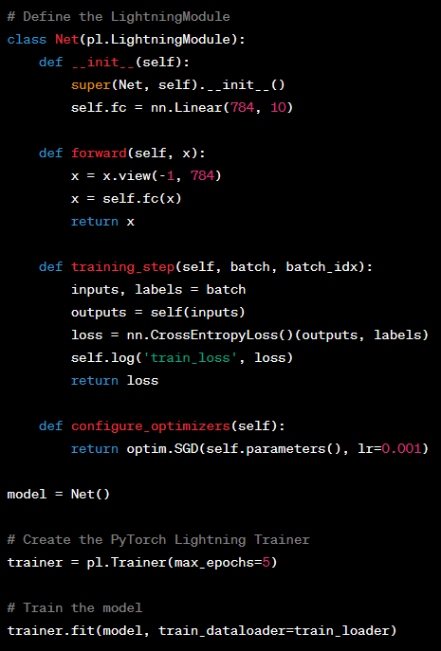
PyTorch Lightning Example – Train a Simple Linear Model
1. Define your model (inheriting from PyTorch Lightning’s “LightningModule”)
2. Calculate your predictions and loss on each training step
3. Configure your optimizer
4. Instantiate your model
5. Instantiate a PyTorch Lightning “Trainer” object
6. Kickoff the training loop of your PyTorch Lightning Model

Slide 9

What is GitHub Copilot?
GitHub Copilot is an AI-powered code completion tool developed by GitHub in collaboration with OpenAI (the makers of ChatGPT)
Copilot learns patterns, syntax, and coding styles and generates relevant code suggestions as you code!
Copilot is currently available as a subscription service ($10/month)

Slide 10
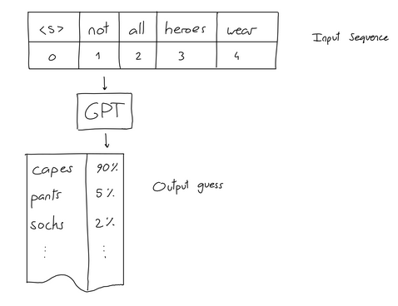
How does GitHub Copilot work? (ML-wise)
Copilot was trained using an aggregation of publicly available code repositories and related documentation
  Repositories were chosen based on popularity, quality, and diversity of language
The training process also leverages OpenAI’s GPT-3 (Generative Pre-trained Transformer 3) language model, which has been pre-trained on a vast amount of text data from the internet
A fine-tuning process further trains GPT-3 by generating code suggestions and completions based on the given context

Slide 11
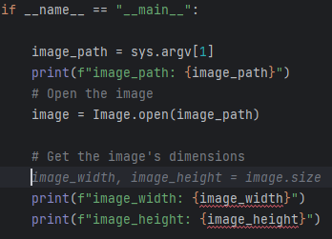
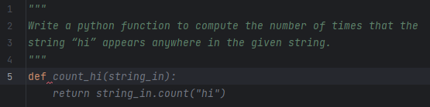
How does GitHub Copilot work? (User-wise)
Code completions will automatically be suggested as you code (based on surrounding context)
You can also write a comment describing what you want Copilot to suggest for you
Once the suggestion pops up, simply press “Tab” to accept the code completion!
You can cycle through suggestions (if available) by pressing “Alt” + “]”

Slide 12





MNIST Classification Using PyTorch Lightning and GitHub Copilot
Coding Exercise

Slide 13
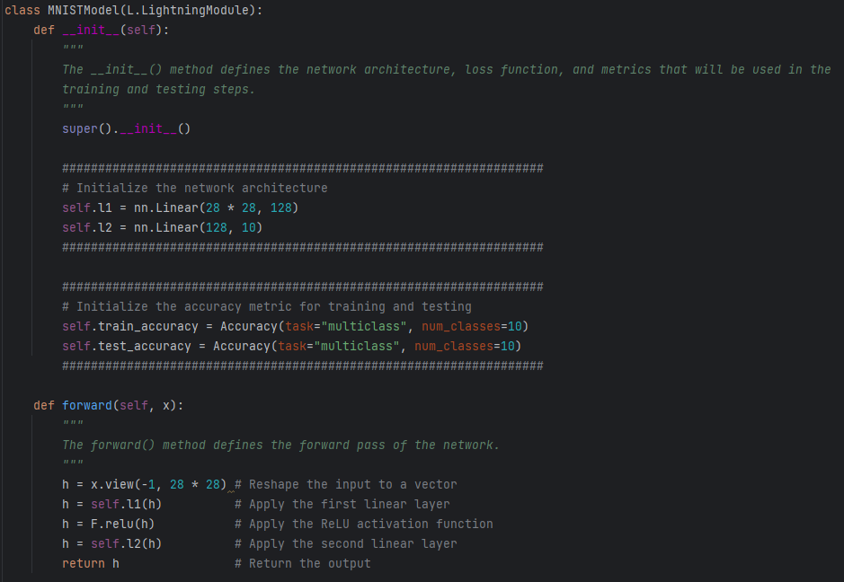

Slide 14
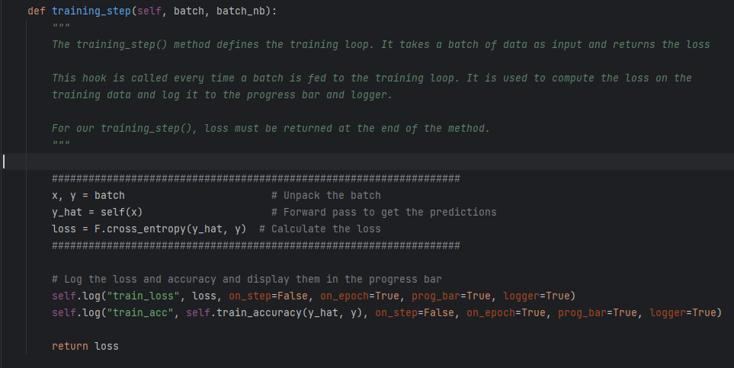

Slide 15
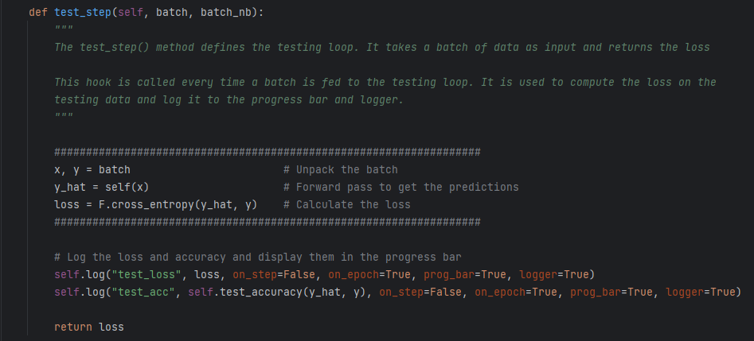

Slide 16
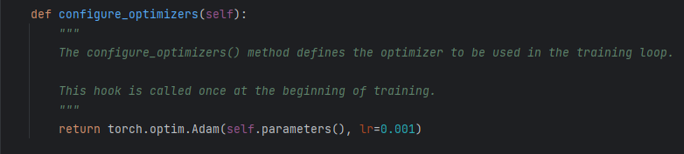

Slide 17
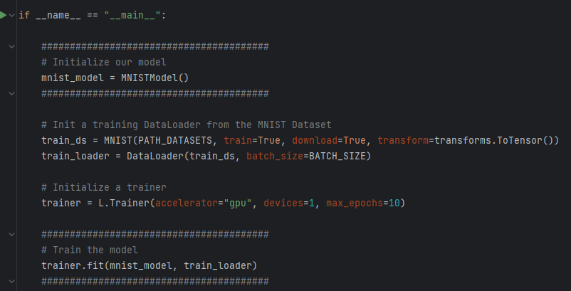

Slide 18
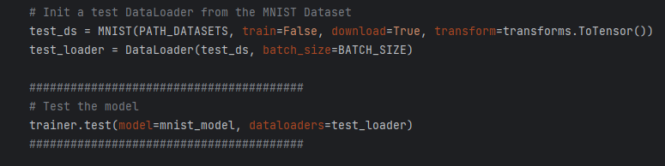

Slide 19
References
[1] H. Khodabakhsh, “Mnist dataset,” Kaggle, https://www.kaggle.com/datasets/hojjatk/mnist-dataset (accessed Jun. 27, 2023).
[2] “GitHub copilot · your AI pair programmer,” GitHub, https://github.com/features/copilot (accessed Jun. 27, 2023).
[3] “Welcome to ⚡ Pytorch lightning¶,” Welcome to ⚡ PyTorch Lightning - PyTorch Lightning 2.1.0dev documentation, https://lightning.ai/docs/pytorch/latest/ (accessed Jun. 27, 2023).
[4] D. Dugas, “How deep is the machine?,” The GPT-3 Architecture, on a Napkin, https://dugas.ch/artificial_curiosity/GPT_architecture.html (accessed Jun. 27, 2023).

